Slide 1
Image Captioning, Arabic Translation and Text-to-Speech (TTS) Pipeline
A demonstration of a machine leaning driven process
Team: 1- Omar Abd Allah Omar
2- Yasmeen Mohamed Abd-Elradi
3- Moataz Hassan Ahmed
4- Rana Talaat Shalaby
Supervised by:
Eng. Ehab Ibrahim

Slide 2
Overview
This project demonstrates a pipeline that processes an input image, generates an English caption, translates it into Arabic, and converts it into spoken Arabic audio using machine learning models.
The purpose is to enhance accessibility, language learning, and seamless language translation through a unified pipeline.

Slide 3
Pipeline Components
Image Captioning: Extracts descriptive captions from images.
Arabic Translation: Converts the English captions to Modern Standard Arabic.
Text-to-Speech: Generates Arabic audio from the translated text.

Slide 4
Model Descriptions
Image Captioning Model:
Model: BLIP (Bootstrapping Language-Image Pre-training)
Functionality: Generates captions based on the content of an input image.
Key Features: Pre-trained for various image scenarios; efficient caption generation.

Slide 5
Model Descriptions cont.
2. Translation Model:
Model: mBART (Multilingual BART - mbart-large-50-many-to-many-mmt)
Functionality: Translates English text into Modern Standard Arabic.
Key Features: Capable of translation across 50+ languages with high accuracy.

Slide 6
Model Descriptions cont.
3. Text-to-Speech Model:
Library: gTTS (Google Text-to-Speech)
Functionality: Converts the Arabic text to spoken audio.
Key Features: Lightweight, provides natural voice output, and is easy to integrate.

Slide 7

Pipeline Architecture
Upload Image
Generate Caption using BLIP
A women taking a photo with a camera
Translate Caption using mBART
امرأه تأخذ صورة بكاميرا
Generate Audio using gTTS

Slide 8
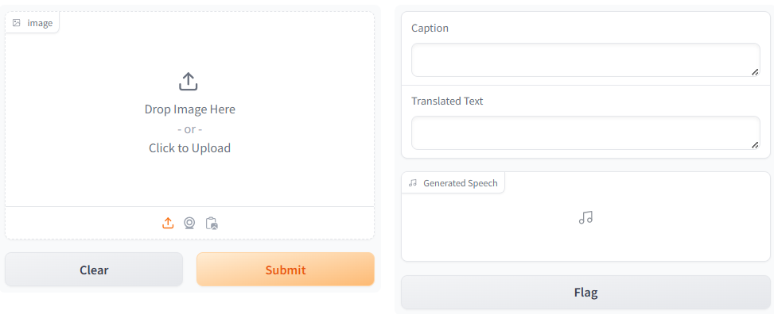
Gradio Interface
The Gradio interface allows users to upload images, automatically receive image captions, and hear the Arabic spoken output without accessing the underlying code.

Slide 9
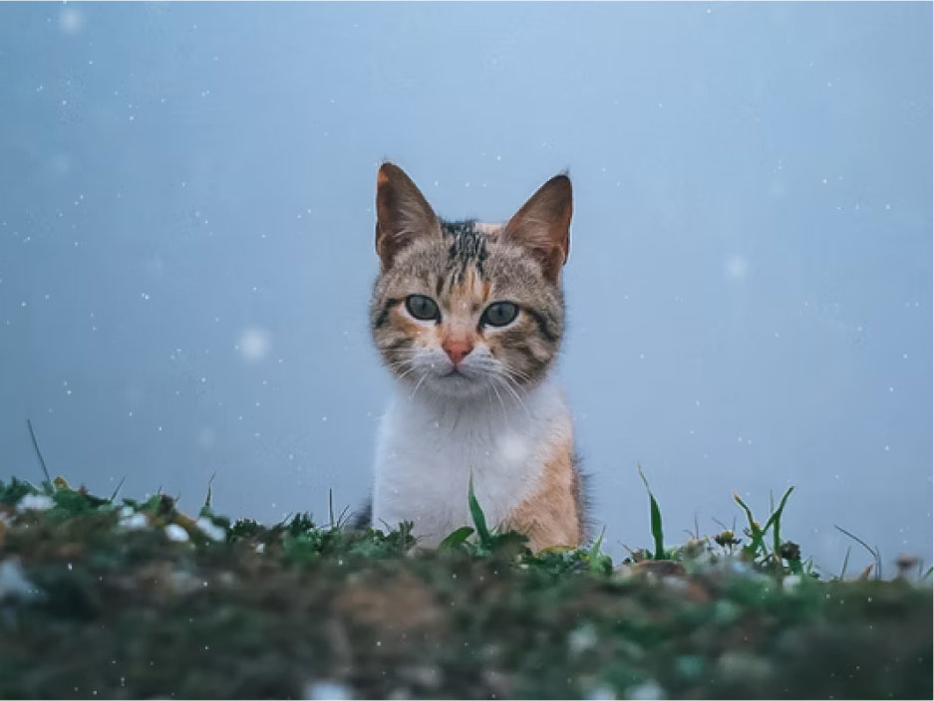
Output Example
Input Example | Generated Caption:
 | a cat sitting in the snow looking at the camera
 | Translated Text:
 | قطة تجلس في الثلج تنظر إلى الكاميرا
 | Audio Output:

Slide 10
Use Cases
Education: Assist Arabic language learners by combining image descriptions with spoken Arabic.
Accessibility: Provide visually impaired users with spoken descriptions of images.
Content Creation: Generate content for social media, marketing, or automated services.

Slide 11
Future Enhancements
Model Optimization: Explore deeper integration with Retrieval-Augmented Generation (RAG) for improved context-based accuracy in translations.
Multilingual Support: Add support for translating captions into additional languages.
Advanced TTS Options: Integrate more diverse TTS engines for a variety of voices and accents.

Slide 12
Conclusion
Recap: This project successfully integrates image processing with natural language processing to provide an accessible, efficient tool for generating and delivering spoken Arabic descriptions of images.
Call to Action:
Encourage users to test the demo and provide feedback for further enhancements

Slide 13


Slide 14


